Slide 1
Cascading Style Sheets (CSS)

Slide 2
Cascading Style Sheets (CSS)
CSS define how HTML elements are to be displayed
CSS is used to define styles for your web pages, including the design, layout and variations in display for different devices and screen sizes.
The separation of structure from content allow a greater manageability and makes changing the style of your document easier
CSS allows to specify the style of a HTML element (H1, P, A, etc.) separately from the structure of your document (section header, body text, links, etc.)

Slide 3
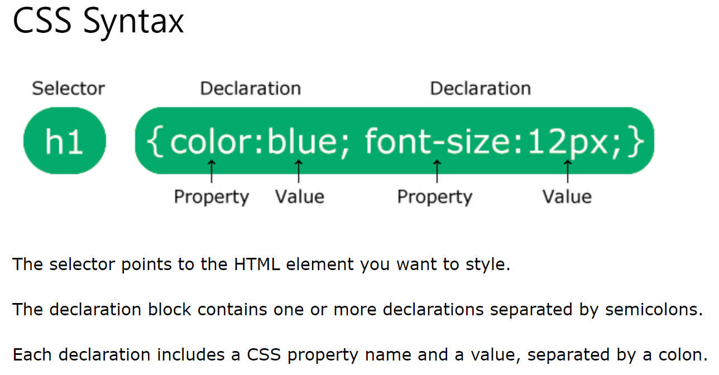
Cascading Style Sheets (CSS) Syntax
A CSS rule consists of a selector and a declaration block.

Slide 4
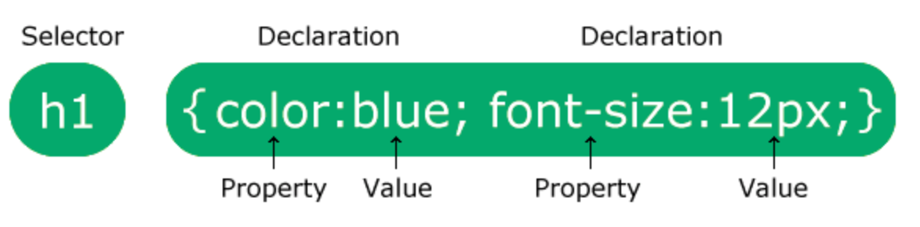
Cascading Style Sheets (CSS) Syntax
h1 is a selector in CSS (it points to the HTML element you want to style: <h1>).
color is a property, and blue is the property value

Slide 5
CSS: Styling Methods
CSS styling can be added to HTML elements in 3 different ways:
Inline:
Using a style attribute in HTML elements or tags
Internal:
Using a <style> </style> elements in the HTML <head> section
External:
Using one or more external CSS files

Slide 6
Inline Styles
Inline styling is useful for applying a unique style to a single HTML element
Individual element’s style defined using STYLE attribute
Each CSS property followed by a colon and the value of that attribute
Multiple properties are separated by semicolons
<p style = “font-size: 20 pt; color: #0000FF”>
Inline styles override any other styles

Slide 7
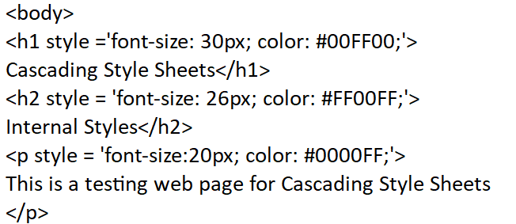
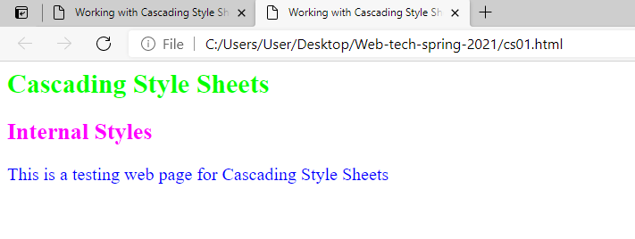

Slide 8
Internal Styles
The Internal Style sheet are set in header section and apply to the whole document
It begins with <STYLE TYPE = “text/css”>
TYPE attribute is set to “text/css” MIME (Multipurpose Internet Mail Extension) type
MIME is a standard for specifying the format of content
Other MIME types include text/html, image/gif and text/javascript

Slide 9
Internal Styles
Declare CSS rules within STYLE element
Each rule body begins and ends with a curly brace ({ and })
Class declarations are preceded with a period and applied to elements only of that specific class
Each property is followed by a colon and the value of the property
Multiple properties are separated by semicolons
Declare rules for the EM, H1 and P elements
Will be modified in the specified manner – universal formatting

Slide 10
Internal Styles
The body of the STYLE sheet includes
EM {background-color: #8000FF; color: white}
H1 {font-family: Arial, sans-serif}
P {font-size: 18pt}

Slide 11
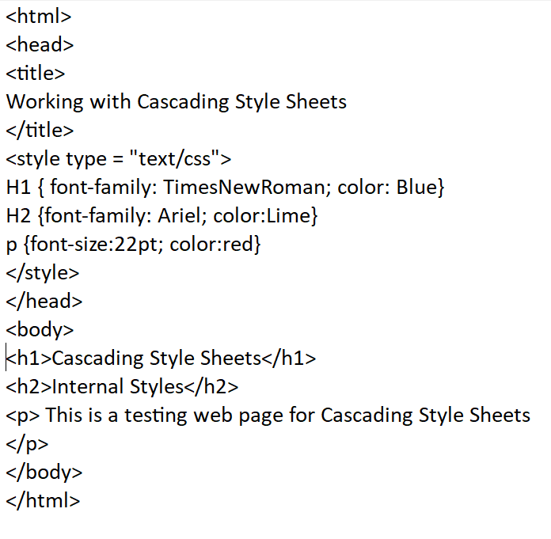
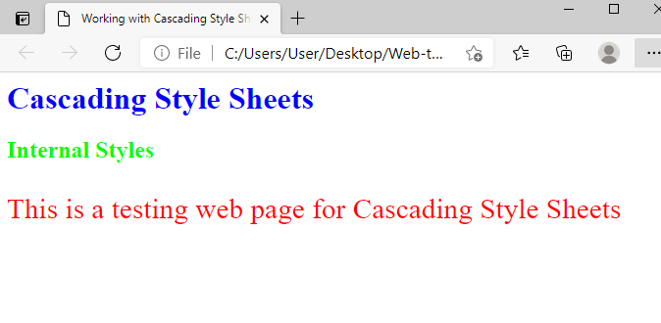

Slide 12
CSS properties
The following properties can be set on any HTML tag in a document.
background-color
border-width
border-color
Padding
font-family
Fontsize, font-style, font-weight
background-image
text-align
text-decoration, vertical-align
Visibility
overflow
....

Slide 13
CSS properties Internal Styles
Font-size property
Relative sizes: xx-small, x-small, small, smaller, medium, large, larger, xlarge and xx-large
Styles applied to an element (the parent element)
Also apply to the elements inside that element (child elements)

Slide 14
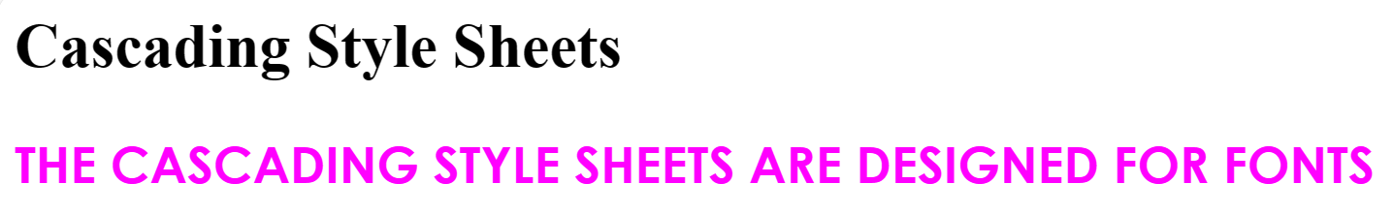
Fonts
<style>
p {font-size: 26px; color: #FF00FF; font-family:Century Gothic; font-style:underline; font-weight:bolder; text-transform: uppercase; }
</style>
</head>
<body>
<h1>
Cascading Style Sheets</h1>
<p>
The Cascading Style Sheets are designed for fonts
</p>
</body>

Slide 15
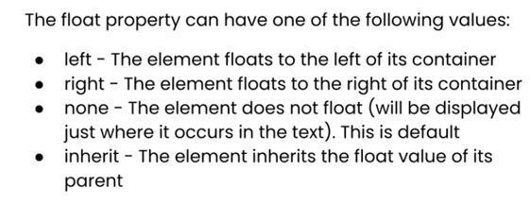
CSS Float
It is used for positioning and formatting content

Slide 16
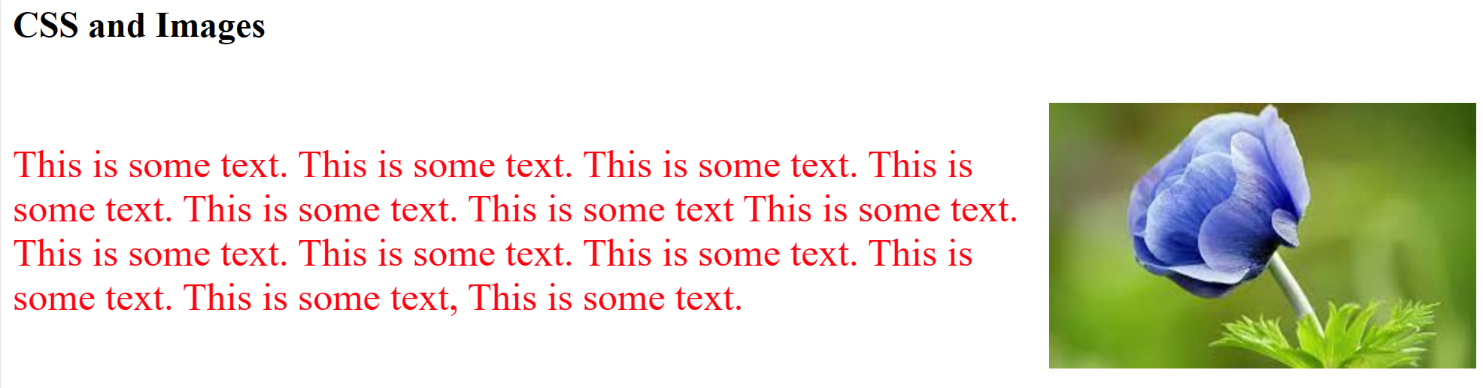
<style>
img{float:right;}
p {font-size: 26px; color: #FF040F;}
</style>
</head>
<body>
<h2>CSS and Images</h2>
<br><img src='flr.jpg'/>
<p>This is some text. This is some text. This is some text. This is some text. This is some text. This is some text
This is some text. This is some text. This is some text. This is some text. This is some text. This is some text, This is some text.
</P>
</body>

Slide 17
CSS Colors
Colors are specified using predefined color names, or RGB, HEX, HSL values.
140 color names and their Hex values are supported by all browsers
Rgb(red,green, blue)
Hex (00ff00)
hsl(hue, saturation, lightness)
Hue is a degree on the color wheel from 0 to 360. 0 (or 360) is red, 120 is green, 240 is blue.
Saturation can be described as the intensity of a color.
Lightness of a color can be described as how much light you want to give the color.

Slide 18
Styling multiple tags
Multiple tags with same styling can be done as below
h1, h2, h3 { color: yellow; background-color: black; }

Slide 19
Types of simple selector
Tag (p, h1, etc)
Id (#top, r1, etc)
Class (.myclass)
Universal (*{color:red;})

Slide 20
<style>
*{background-color:lightgrey;}
* is used to apply the color to entire page
Or
*{background-color: rgb(255,0,0);}
Or
*{background-color:00ff00;}

Slide 21
Internal Styles
Declare a style class name blue
Class declaration are preceded with a period and are applied to elements only of that specific class
Class is used in element with CLASS attribute
<P CLASS = “blue”> ------ </P>
<H1 CLASS = “blue”> ------ </h1>
The text appears in the properties of both element and the style class
Generic font families
Allow you to specify a type of font instead of a specific font

Slide 22
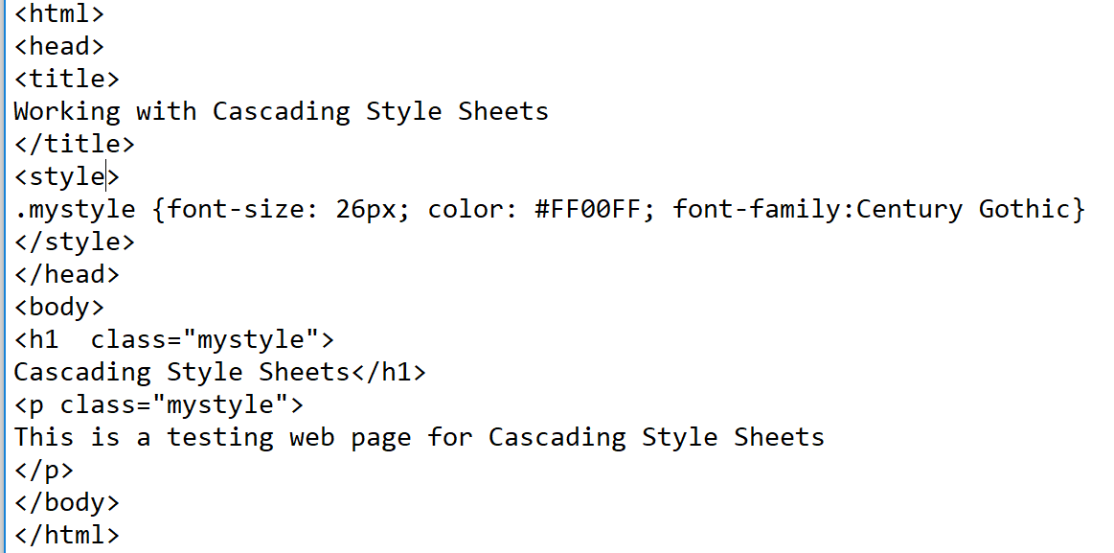
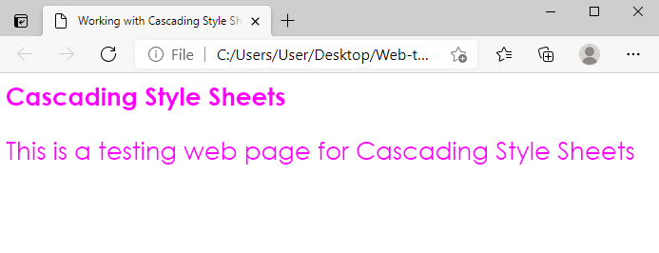

Slide 23
Lab-6
Design a webpage and format using all the options of CSS covered in lecture

